Slide 1
Data Integration and Structured Search

Slide 2
RDF – a language for linking data
URIs are the words of the language.
URIs provide global identity independently of application context.
Domain Name system provides global distributed namespace management.
“Follow your nose”: documentation should be available available on the Web through the URIs.

Slide 3
How to create and query linked data
1. Express the data (from various sources) in RDF.
2. Combine the RDF data into one whole.
3. Query the combined whole for Web-link patterns.

Slide 4
RDF – a grammar for Web links
ResourceA
Resource
ResourceB
Resource
relatedToy
ResourceA
Resource
describedByy
Some text
http://dublincore.org/workshops/dc6/pp/miller-datamodel.ppt, 1998

Slide 5

Source A: About a book by Barack Obama
dct:title
“Dreams from My Father”
http://...2773
dct:date
2004
dct:creator
_:placeholder
“Barack Obama”
foaf:name
Note that each Web link is expressed in the data as
a triple – a three-part data structure.
Each triple in the data corresponds to a link in a
conceptual graph.
http://../isbn/978-14000082773 dct:title “Dreams from My Father”
http://../isbn/978-14000082773 x:published “2004”
http://../isbn/978-14000082773 dct:creator _:placeholder
_:placeholder foaf:name “Barack Obama”

Slide 6

Source B: About the French translation
x:isTranslationOf
http://...2773
http://...5979
dct:title
“Les rêves de mon père”
X:translator
_:placeholder
“Danièle Darneau”
foaf:name
http://../isbn/978-2258075979 x:isTranslationOf http://.../isbn/978-14000082773
http://../isbn/978-2258075979 dct:title “Les rêves de mon père”
http://../isbn/978-2258075979 x:translator _:placeholder
_:placeholder foaf:name “Danièle Darneau”

Slide 7
Merge the two data sources into one set of triples
http://../isbn/978-2258075979 x:isTranslationOf http://.../isbn/978-14000082773
http://../isbn/978-2258075979 dct:title “Les rêves de mon père”
http://../isbn/978-2258075979 x:translator _:placeholder
_:placeholder foaf:name “Danièle Darneau”
http://../isbn/978-14000082773 dct:title “Dreams from My Father”
http://../isbn/978-14000082773 x:published “2004”
http://../isbn/978-14000082773 dct:creator _:placeholder
_:placeholder foaf:name “Barack Obama”

Slide 8
The processor will detect the matching URIs…
http://../isbn/978-2258075979 x:isTranslationOf http://.../isbn/978-14000082773
http://../isbn/978-2258075979 dct:title “Les rêves de mon père”
http://../isbn/978-2258075979 x:translator _:placeholder
_:placeholder foaf:name “Danièle Darneau”
http://../isbn/978-14000082773 dct:title “Dreams from My Father”
http://../isbn/978-14000082773 x:published “2004”
http://../isbn/978-14000082773 dct:creator _:placeholder
_:placeholder foaf:name “Barack Obama”

Slide 9
The processor will detect the matching URIs…
dct:title
“Dreams from My Father”
http://...2773
dct:date
2004
dct:creator
_:placeholder
“Barack Obama”
foaf:name
x:isTranslationOf
http://...2773
http://...5979
dct:title
“Les rêves de mon père”
X:translator
_:placeholder
“Danièle Darneau”
foaf:name

Slide 10
…and merge the data
dct:title
“Dreams from My Father”
http://...2773
dct:date
2004
dct:creator
x:isTranslationOf
_:placeholder
“Barack Obama”
foaf:name
http://...5979
dct:title
“Les rêves de mon père”
X:translator
_:placeholder
“Danièle Darneau”
foaf:name

Slide 11
Let’s use a Dbpedia URI to identify Barack Obama…
“Les rêves de mon père”
dct:title
dct:title
“Dreams from My Father”
http://...5979
http://...2773
x:isTranslationOf
dct:date
X:translator
2004
dct:creator
_:placeholder
“Danièle Darneau”
foaf:name
http://...Obama
“Barack Obama”
foaf:name
_:placeholder foaf:name “Barack Obama”
http://dbpedia.org/resource/Barack_Obama foaf:name “Barack Obama”

Slide 12
Wikipedia mentions a book in German about Obama
“Les rêves de mon père”
dct:title
dct:title
“Dreams from My Father”
http://...5979
http://...2773
x:isTranslationOf
dct:date
X:translator
2004
dct:creator
_:placeholder
“Danièle Darneau”
foaf:name
http://...Obama
“Barack Obama”
foaf:name
dct:subject
http://...Kennedy
“Der schwarze Kennedy”
dct:title
http://dbpedia.org/...Kennedy¹ dct:subject http://...Obama
http://dbpedia.org/...Kennedy dct:title “Der schwarze Kennedy”
¹ Full URI: http://dbpedia.org/resource/Barack_Obama_-_Der_schwarze_Kennedy

Slide 13
New York Times also has a URI for Obama, which it links to Dbpedia’s, leading to more information…
“Les rêves de mon père”
dct:title
dct:title
“Dreams from My Father”
http://...5979
http://...2773
x:isTranslationOf
dct:date
X:translator
2004
dct:creator
_:placeholder
“Danièle Darneau”
foaf:name
http://...Obama
“Barack Obama”
foaf:name
owl:sameAs
http://...6853
x:topicPage
http://topics.nytimes.com/top/reference/timestopics/people/o/barack_obama/index.html
“Barack Obama”
http://data.nytimes.com/...6853¹ owl:sameAs http://...Obama
http://data.nytimes.com/...6853 x:topicPage http://topics.nytimes.com/...
¹ Full URI: http://data.nytimes.com/47452218948077706853

Slide 14
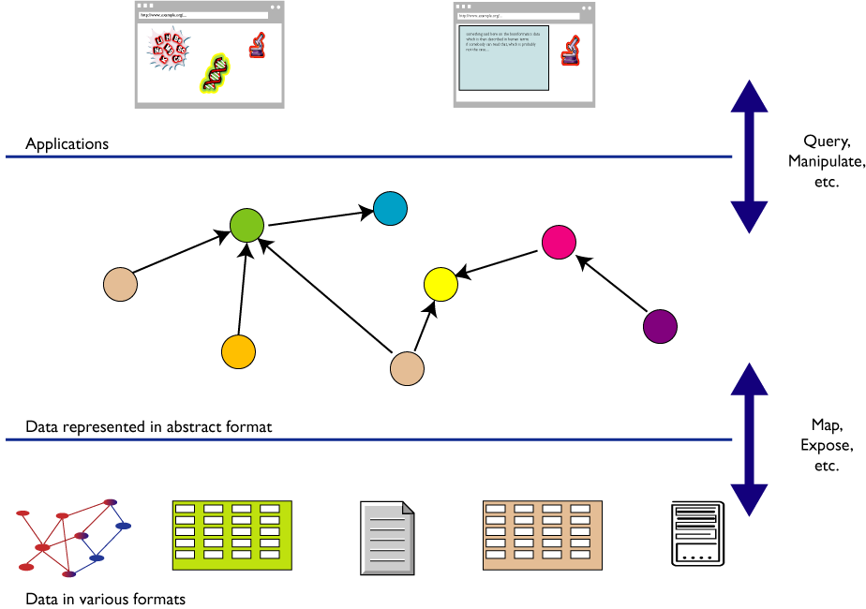
RDF as a common format for merging data
http://www.w3.org/2007/Talks/0221-Bangalore-IH/

Slide 15
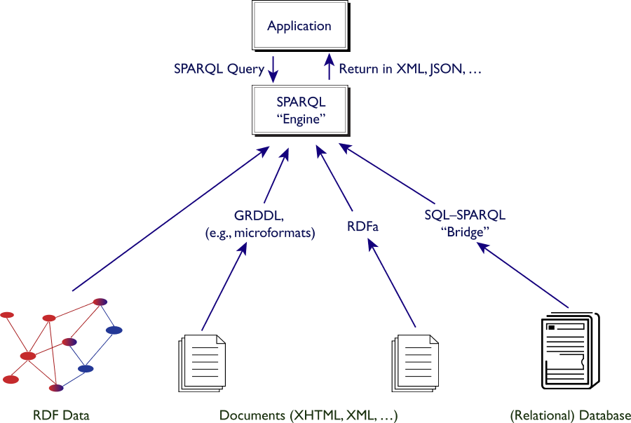
Merged data is queried with SPARQL
Queries are
expressed as
RDF triples
with unknown
variables.
Source: Ivan Herman, http://www.w3.org/2007/Talks/0221-Bangalore-IH/

Slide 16
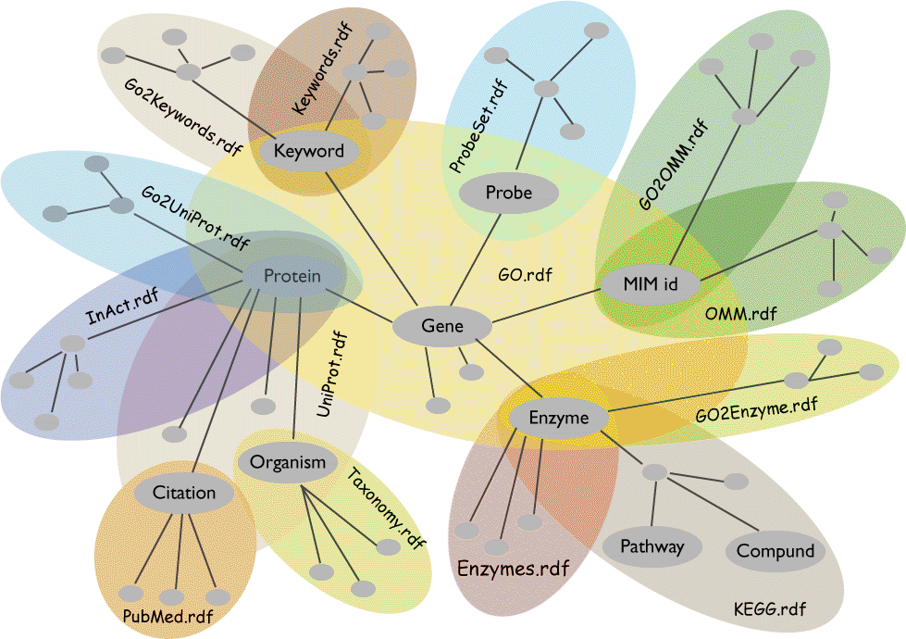
Finding things related to “genes” across databases
Source: Joanne Luciano, Mitre, and the W3C HCLS IG

Slide 17
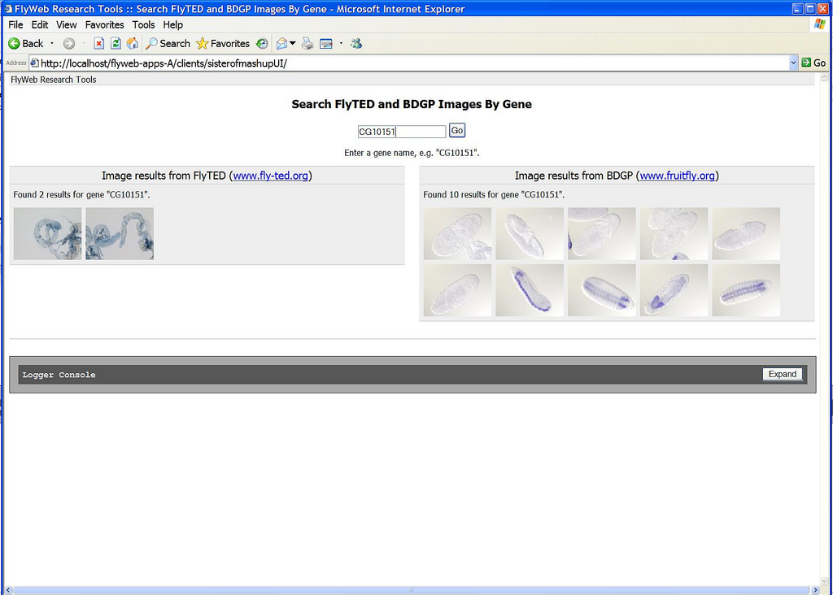
http://openflydata.org
[insert screenshot of mashup]
http://purl.org/net/aliman
17

Slide 18
Creating a Web of Data (Linked Data)
Value of information as function of what it links to (Tim Berners-Lee)‏
Four rules for maximizing “unplanned re-use”
1. Identify things with URIs.
2. Use HTTP URIs.
3. Serve information on the Web against the URIs.
4. Link related material.
http://www.w3.org/DesignIssues/LinkedData.html

Slide 19
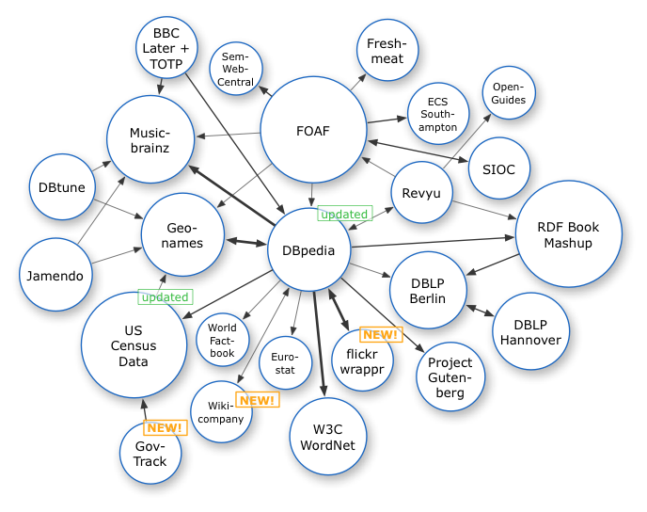
Linked Data Cloud, 2007
http://dbpedia.org

Slide 20
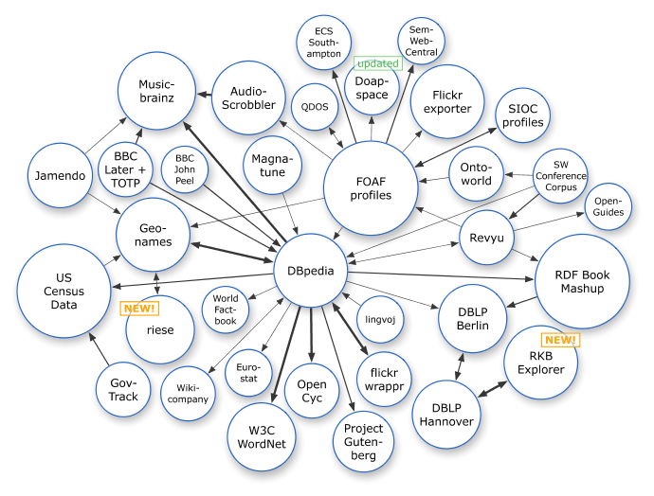
Linked Data Cloud, March 2008

Slide 21
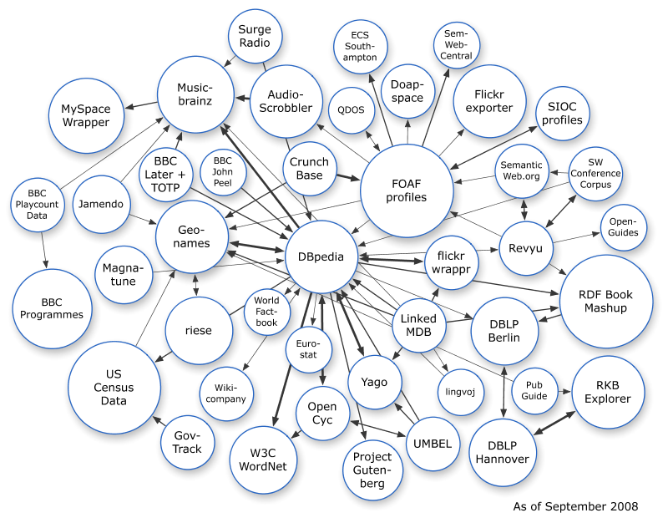
Linked Data Cloud, September 2008

Slide 22
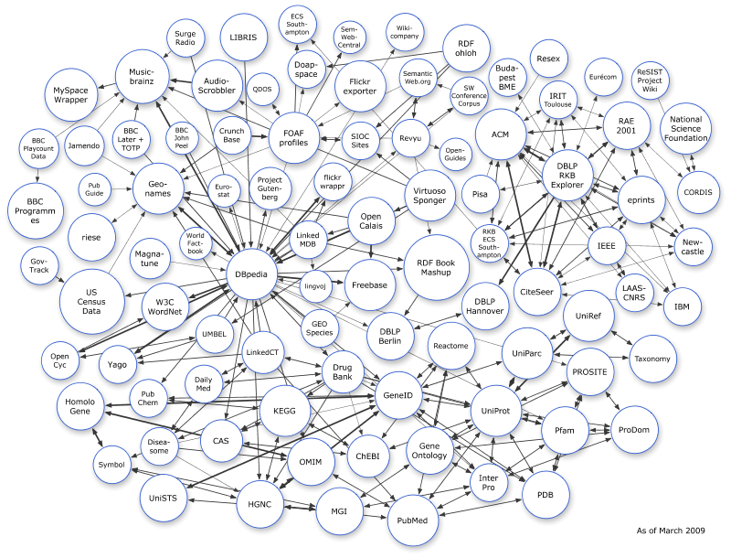
Linked Data Cloud, March 2009

Slide 23
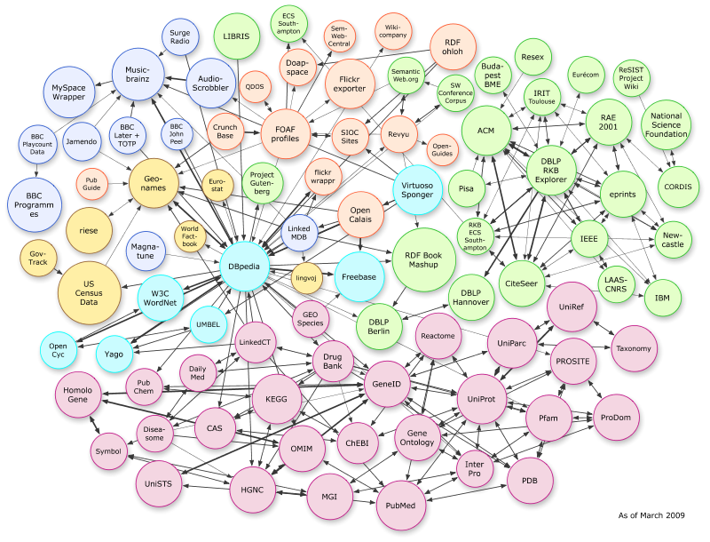
Application-specific parts of the cloud
“Bio”-related datasets
Thanks to “Linking Open Drug Data” task force of the HCLS at W3C

Slide 24
Embedded metadata and structured search

Slide 25
Extracting triples from Web pages
GRDDL (Gleaning Resource Descriptions from Dialects of Languages)‏
Mechanism for extracting structured data from XML and XHTML documents and converting that data (via an XSLT script) into RDF
RDFa (“RDF-in-attributes”)‏
Embeds RDF-structured data into Web pages
Extends XHTML with attributes for carrying RDF data
Data can be cut-and-paste between RDF-aware applications
Humans see a normal-looking Web page. Machines can download the embedded RDF data.
Microformats
Small XML formats to embed in Web pages
Work well for well-defined contact (hCard) or calendar (hCal) information, but fields not designed to be shared across formats
GRDDL can be used to extract RDF triples from Microformats

Slide 26
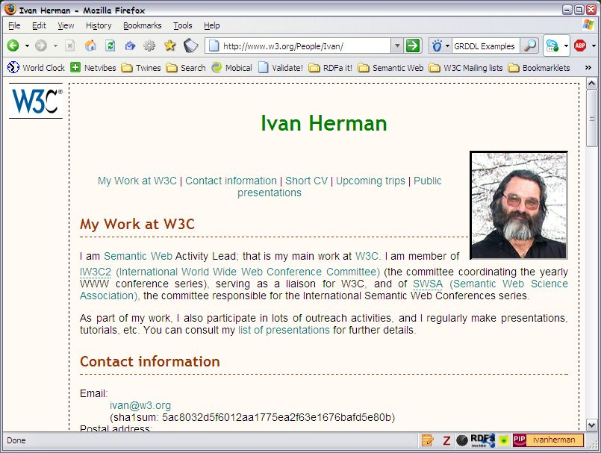
RDFa (RDF attributes) embedded in Web pages
Source: http://www.w3.org/2009/Talks/0615-SanJose-tutorial-IH/

Slide 27
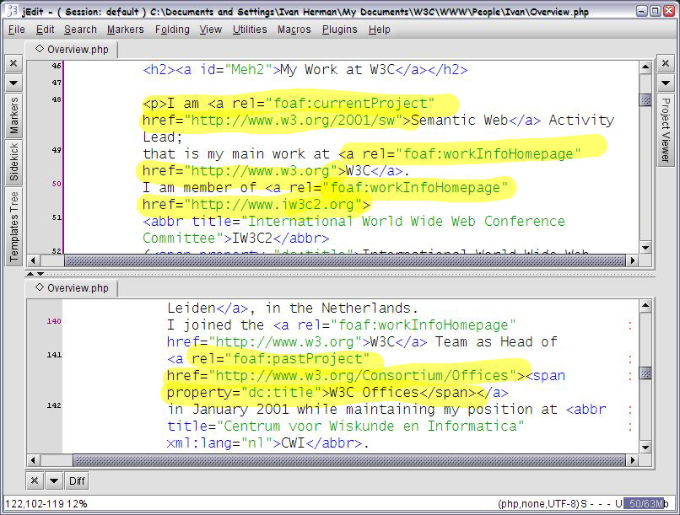
...triples are extracted from hidden attributes
Source: http://www.w3.org/2009/Talks/0615-SanJose-tutorial-IH/

Slide 28
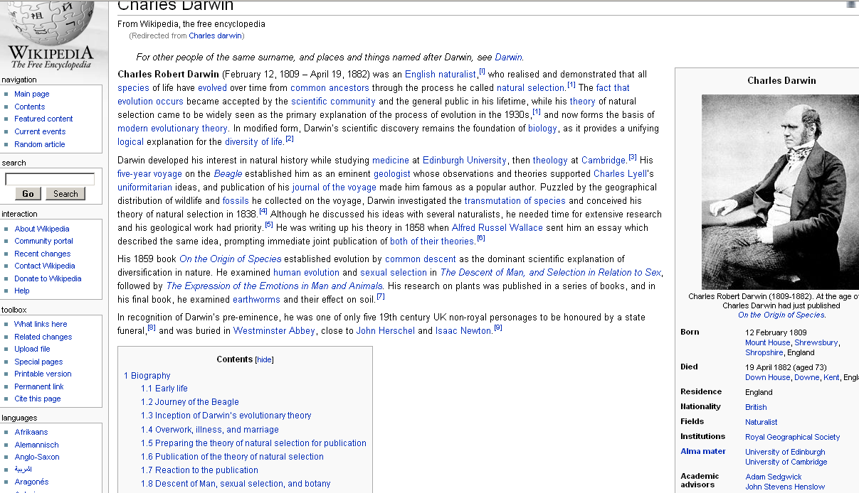
DBPedia extracts data from Wikipedia infoboxes...

Slide 29
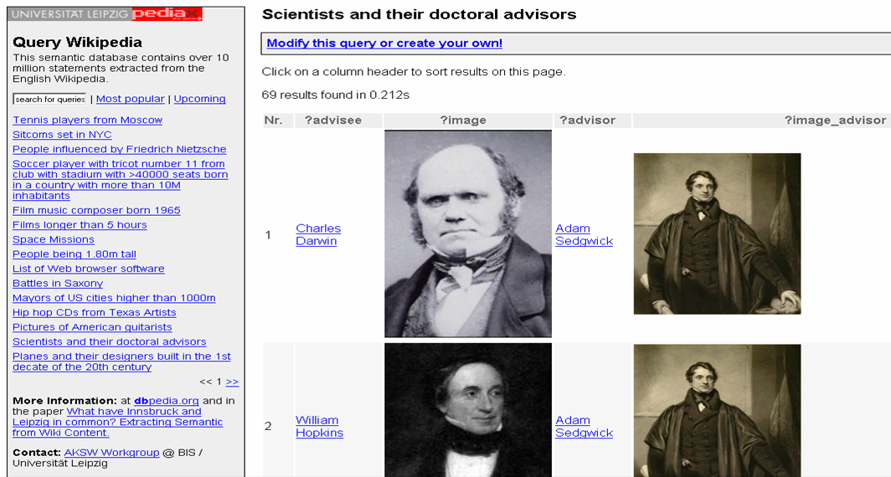
Merged data can be queried
Source: DBPedia

Slide 30
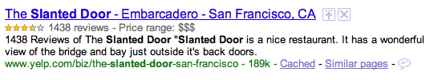
“Structured search”
Yahoo SearchMonkey and Google Rich Snippets
Harvest RDFa and microformat metadata from Web pages
Customized “enhanced display” of search results
Metadata (embedded with RDFa or served via feeds) is collected by Slurp, Yahoo’s crawler
Search results are presented according to customized templates
Harvested data allows construction of specialized databases of products, people, places, events.

Slide 31
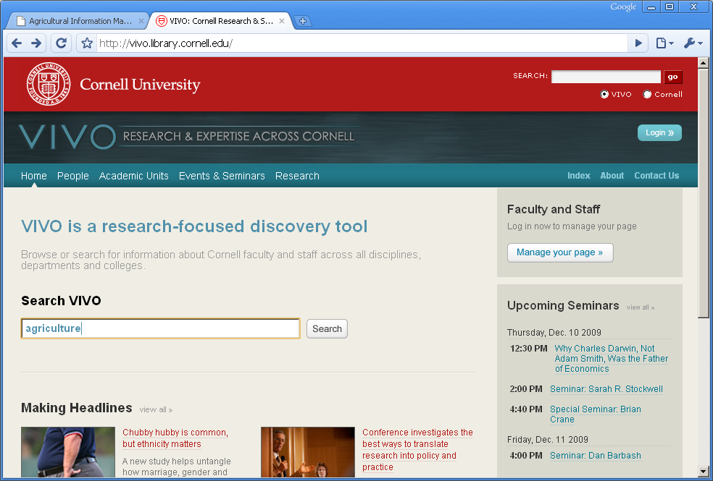
Structured browsing: may start with “Google-like” query…
Source: http://vivo.library.cornell.edu/

Slide 32
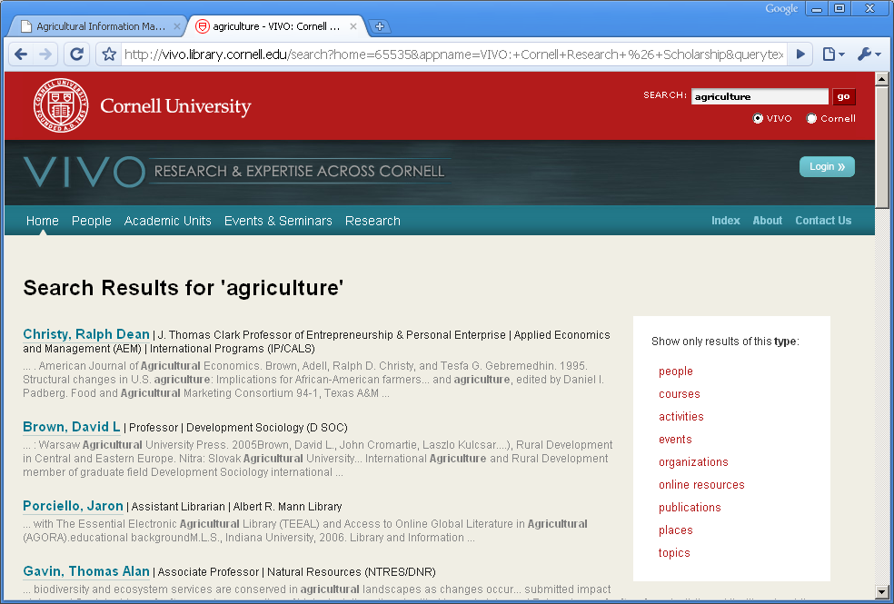
VIVO (at Cornell) clusters results by type

Slide 33
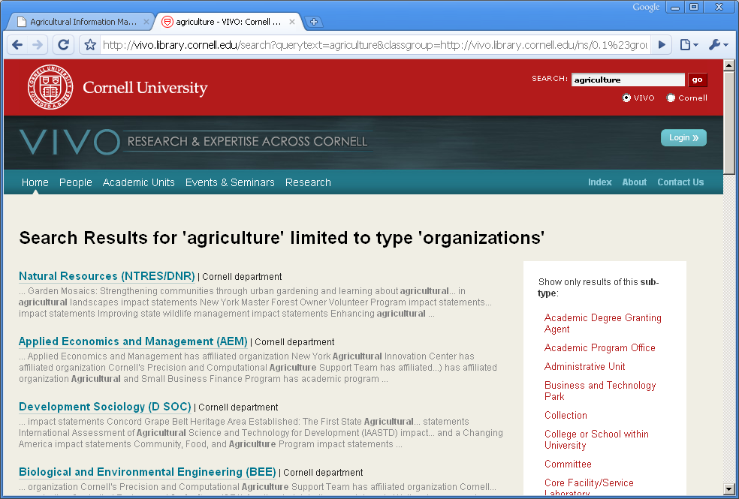
Focus in on one type…

Slide 34
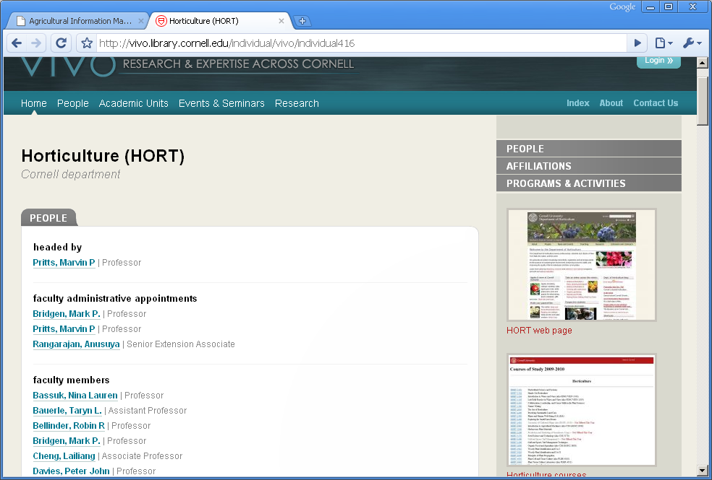
Explore from multiple angles

Slide 35
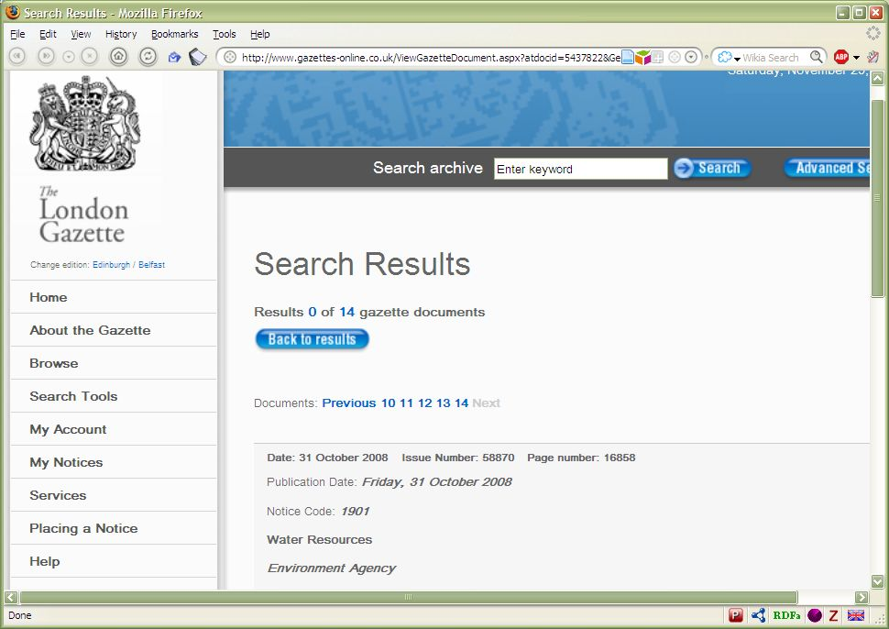
E-Government data (example London Gazette)
Icons indicating embedded RDF

Slide 36
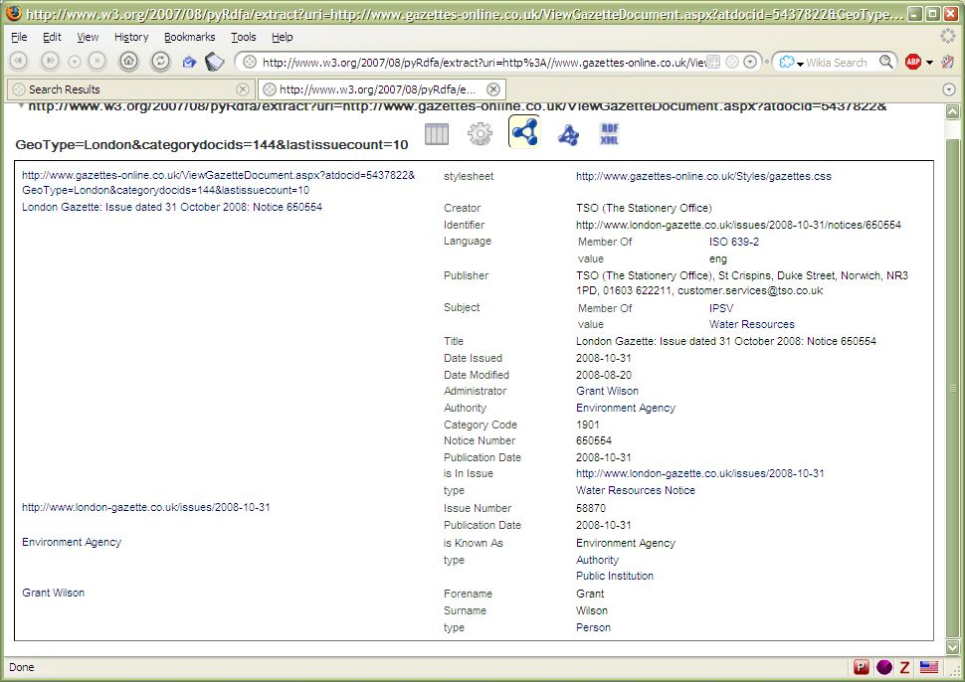
…with RDF under the hood

Slide 37
Leveraging Content Management Systems
London Gazette – UK Office of Public Sector Information (OPSI)
“Approaches to exposing government data need to be both pragmatic and achievable, without requiring wholesale changes to existing IT infrastructure”.
Existing database-driven Websites can be “tweaked” to serve RDF data.
Some data is well-structured :lists of schools and hospitals, statistics…
Most data is semi-structured, with semantics embedded in free text.
Existing taxonomies of fish types or military vehicles need to be “Webified”

Slide 38
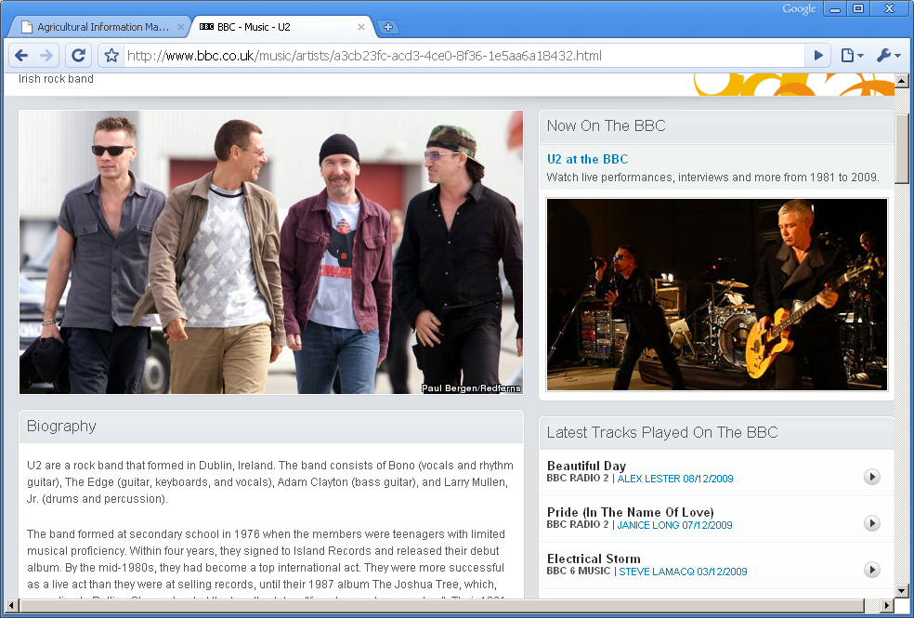
Mainstream media sites like BBC
Source: http://www.bbc.co.uk/music/artists

Slide 39
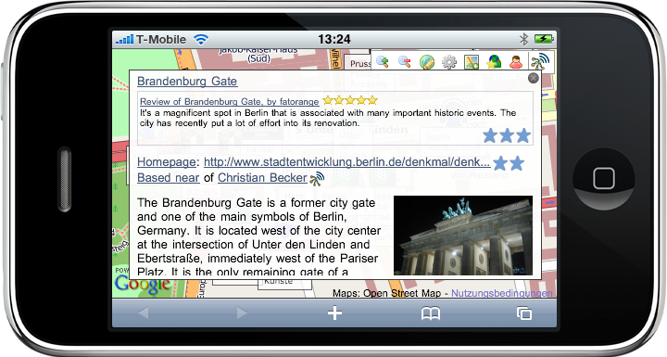
...maybe view on your phone
Source: Chris Bizer and Christian Becker, Freie Universität, Berlin

